Slide 1

Project 4
Tongchen He
Joshua Hernandez
Cameron Song
Tien Tran
Ben Wynne

Slide 2
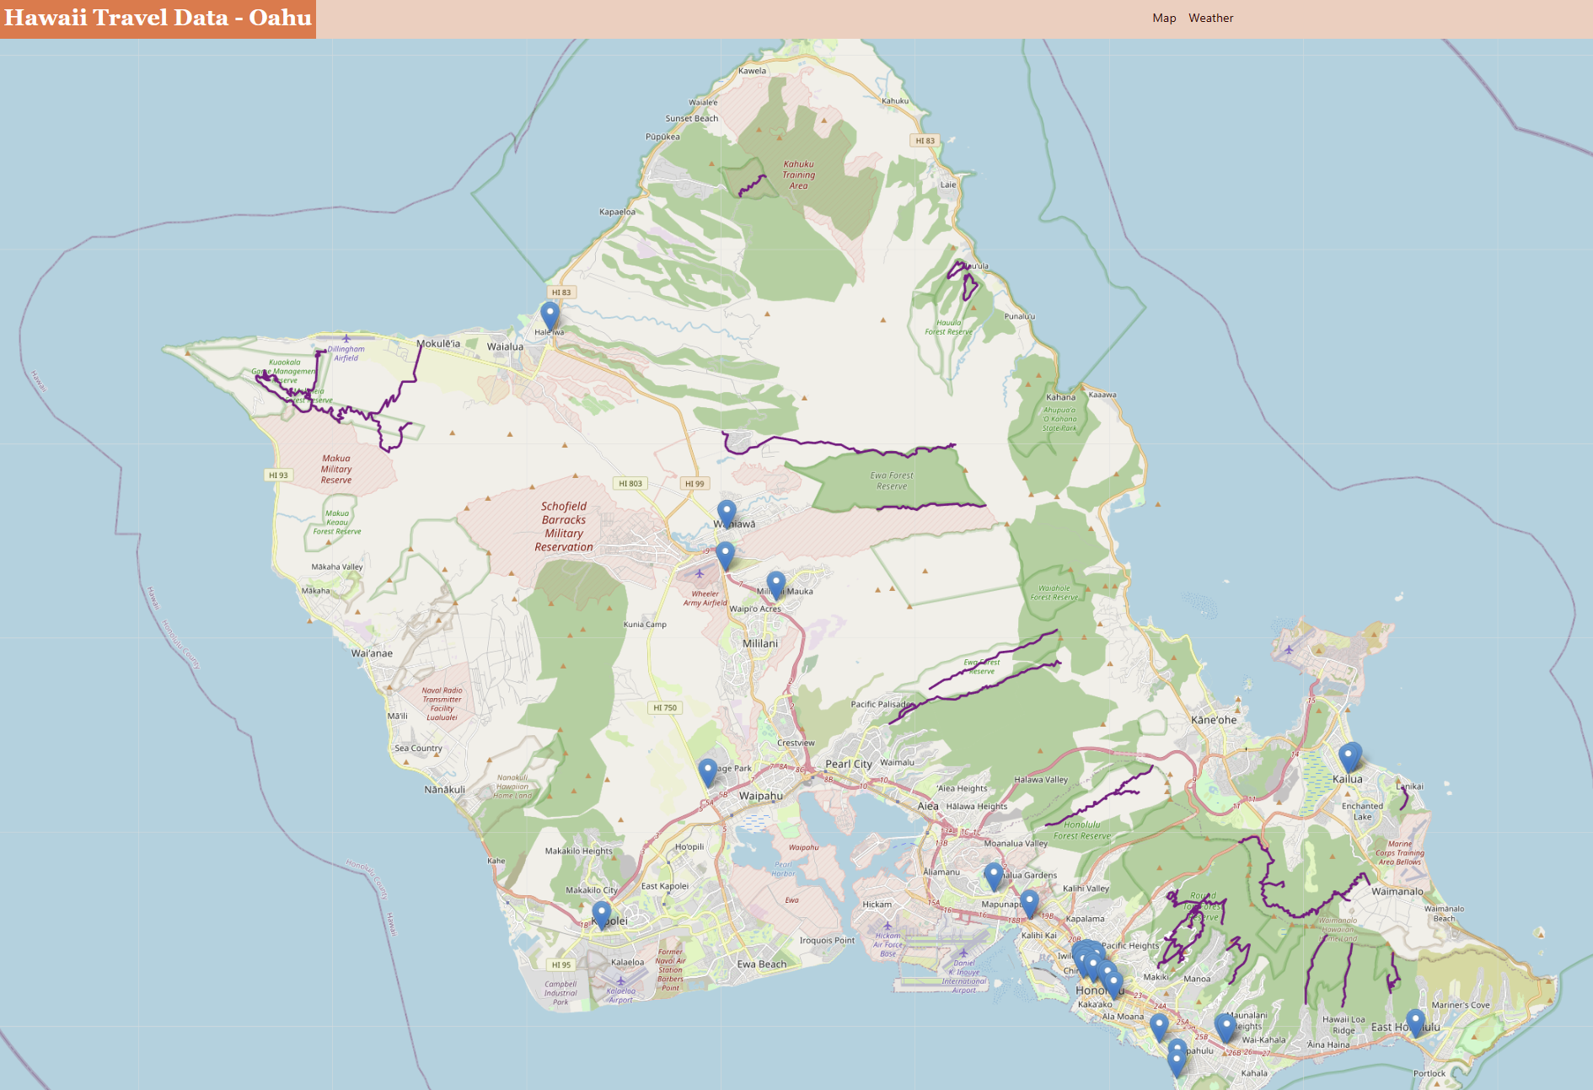
Recap of Project 3

Slide 3

New studies
COVID
-New cases vs deaths
Airfare
-Pricing predictions
Weather
-Tableau visualizations

Slide 4

COVID Presence in Hawaii
New Cases vs Deaths

Slide 5

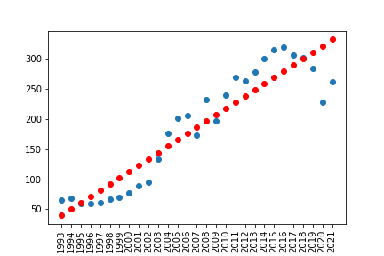

Linear Model of Airfares
Data
Pricing
R² = 0.86

Slide 6
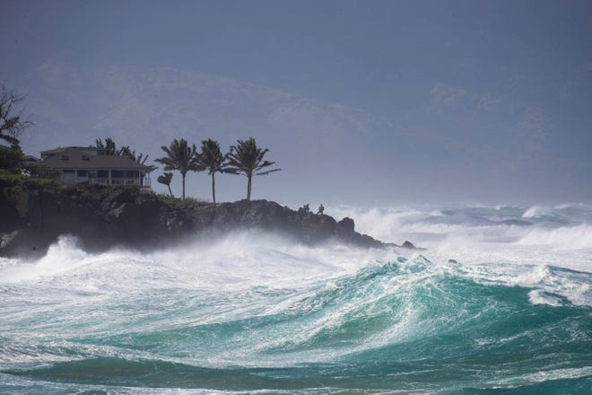
Weather Visualizations
Weather data from SQLITE
Cloudiness
Wind Speed
Humidity
Temperature

